Slide 1
People and parcel share a ride: Minimize longest road among vehicles
Table of contents
Group 8
01
Introduction
02
Solution:
Exact Algorithms (CP & ILP)
Greedy Algorithms
Genetic Algorithms
03
Conclusion

Slide 2
Table of contents
01
Introduction
02
Solution:
People and parcel share a ride: Minimize longest road among vehicles
01
Exact Algorithms (CP & ILP)
Greedy Algorithms
Genetic Algorithms
03
Conclusion
Introduction People and Parcel share a ride

Slide 3







01
Introduction People and Parcel share a ride
Table of contents
A vehicle routing problem where:
K taxis (1, 2, 3, …, K)
01
Introduction
02
Solution:
Exact Algorithms (CP & ILP)
Genetic Algorithm
Greedy Algorithm
Exact Algorithms (CP & ILP)
Greedy Algorithms
Genetic Algorithms
Serving transport requests for N passengers (1, 2, 3, …, N) and M parcels (1, 2, 3, …, M)
03
Conclusion
Our goal is to minimize the length of the longest road among taxis

Slide 4
01
Constraints for this problem
02
03
A vehicle routing problem where:
K taxis (1, 2, 3, …, K)
Each parcel has a pickup point i + N and drop-off point i + N + M
Each passenger must be served by a direct trip
(without interruption)
01
Each passenger has a pickup point i and drop-off point i + N + M
Serving transport requests for N passengers (1, 2, 3, …, N) and M parcels (1, 2, 3, …, M)
04
Each taxis has capacity Q[k] for parcel requests
05
Our goal is to minimize the length of the longest road among taxis
Each parcel has capacity q[i] for request
Introduction People and Parcel share a ride

Slide 5
Constraints for this problem
Solutions for the problem
02
A vehicle routing problem where:
K taxis (1, 2, 3, …, K)
01
02
03
Each passenger has a pickup point i and drop-off point i + N + M
Each parcel has a pickup point i + N and drop-off point i + N + M
Each passenger must be served by a direct trip
(without interruption)
Serving transport requests for N passengers (1, 2, 3, …, N) and M parcels (1, 2, 3, …, M)
04
05
Our goal is to minimize the length of the longest road among taxis
Each taxis has capacity Q[k] for parcel requests
Each parcel has capacity q[i] for request

Slide 6
02
Solutions for the problem
Constraints for this problem
01
03
02
Each passenger has a pickup point i and drop-off point i + N + M
Each passenger must be served by a direct trip
(without interruption)
Each parcel has a pickup point i + N and drop-off point i + N + M
04
05
Each taxis has capacity Q[k] for parcel requests
Each parcel has capacity q[i] for request
Exact solutions:
Integer Linear Programming
Exact solutions:
Integer Linear Programming

Slide 7

02
B = {0,…, 2N + 2M + 1}
F = {(i, i) | i ∈ B}
A = B² \ F
A_{N} = {(i, j) | i ∈{1,…,N}}
A⁺(j) = { j | (i, j) ∈A}
A⁻(j) = { j | (j, i) ∈ A}
Exact solutions:
Integer Linear Programming
B = {0,…, 2N + 2M + 1}
F = {(i, i) | i ∈ B}
A = B² \ F
A_{N} = {(i, j) | j ∈{1,…,N}}
A⁺(j) = { j | (i, j) ∈A}
A⁻(j) = { j | (j, i) ∈ A}
Solutions for the problem

Slide 8

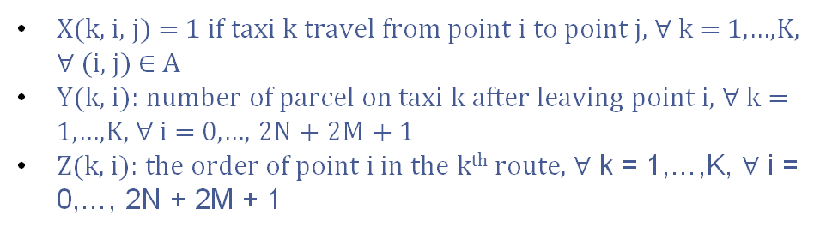
Exact solutions:
Integer Linear Programming
B = {0,…, 2N + 2M + 1}
F = {(i, i) | i ∈ B}
A = B² \ F
A_{N} = {(i, j) | j ∈{1,…,N}}
A⁺(j) = { j | (i, j) ∈A}
A⁻(j) = { j | (j, i) ∈ A}
X(k, i, j) = 1 if taxi k travel from point i to point j, ∀ k = 1,…,K, $∀$(i, j) ∈ A
Y(k, i): number of parcel on taxi k after leaving point i, ∀ k = 1,…,K, ∀ i = 0,…, 2N + 2M + 1
Z(k, i): the order of point i in the k^{th} route, ∀ k = 1,…,K, ∀ i = 0,…, 2N + 2M + 1
Expanding list q
Example: N, M, K = 3, 3, 2
q = [8, 4, 5]
=>q = [0, 0, 0, 0, 8, 4, 5, 0, 0, 0, -8, -4, -5, 0]

Slide 9
B = {0,…, 2N + 2M + 1}
F = {(i, i) | i ∈ B}
A = B² \ F
A_{N} = {(i, j) | j ∈{1,…,N}}
A⁺(j) = { j | (i, j) ∈A}
A⁻(j) = { j | (j, i) ∈ A}
X(k, i, j) = 1 if taxi k travel from point i to point j, ∀ k = 1,…,K, $∀$(i, j) ∈ A
Y(k, i): number of parcel on taxi k after leaving point i, ∀ k = 1,…,K, ∀ i = 0,…, 2N + 2M + 1
Z(k, i): the order of point i in the k^{th} route, ∀ k = 1,…,K, ∀ i = 0,…, 2N + 2M + 1
Expanding list q
Example: N, M, K = 3, 3, 2
q = [8, 4, 5]
=>q = [0, 0, 0, 0, 8, 4, 5, 0, 0, 0, -8, -4, -5, 0]

Slide 10

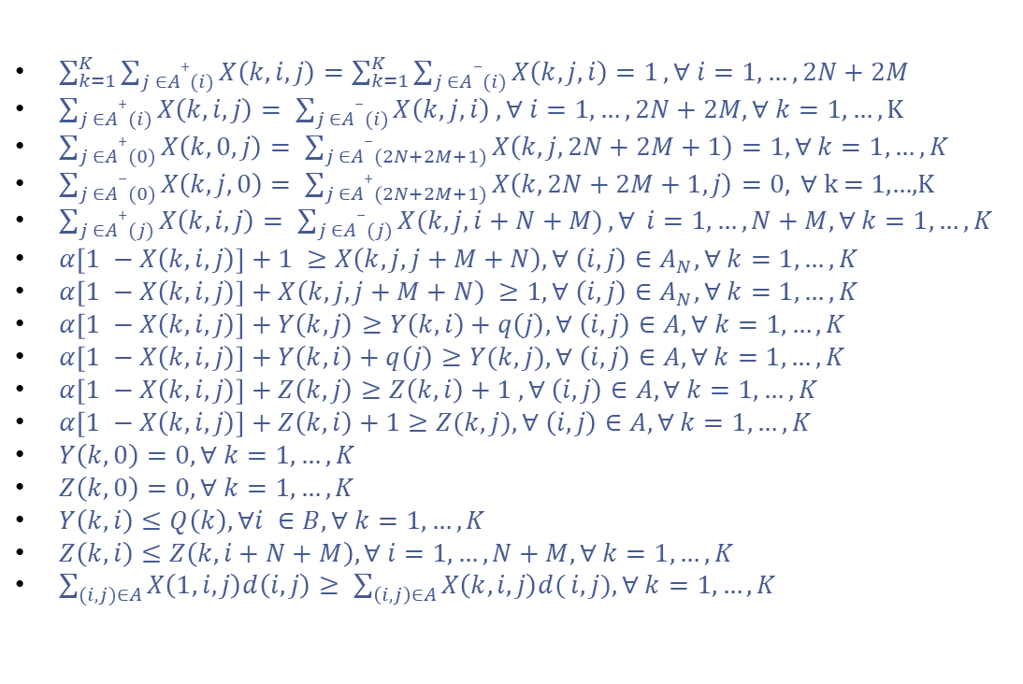
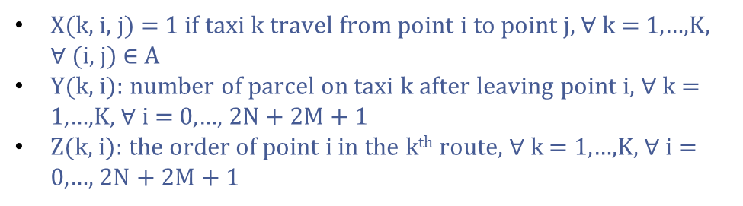
Objective function
Expanding list q
Example: N, M, K = 3, 3, 2
q = [8, 4, 5]
=>q = [0, 0, 0, 0, 8, 4, 5, 0, 0, 0, -8, -4, -5, 0]
X(k, i, j) = 1 if taxi k travel from point i to point j, ∀ k = 1,…,K, $∀$(i, j) ∈ A
Y(k, i): number of parcel on taxi k after leaving point i, ∀ k = 1,…,K, ∀ i = 0,…, 2N + 2M + 1
Z(k, i): the order of point i in the k^{th} route, ∀ k = 1,…,K, ∀ i = 0,…, 2N + 2M + 1
$\sum_{k=1}^{K}{\sum_{j ∈A+(i)}{X\left(k, i, j\right)=\sum_{k=1}^{K}{\sum_{j ∈A−(i)}{X\left(k, j, i\right)=1}}}}, ∀ i=1,…,2N+2M$
$\sum_{j ∈A+(i)}{X\left(k, i, j\right)= \sum_{j ∈A−(i)}{X\left(k, j, i\right) , ∀ i=1,…,2N+2M, ∀ k=1,…,}}K$
$\sum_{j ∈A+(0)}{X\left(k, 0, j\right)= \sum_{j ∈A−(2N+2M+1)}{X\left(k, j, 2N+2M+1\right)}}=1, ∀ k=1, …, K$
$\sum_{j ∈A−(0)}{X\left(k, j, 0\right)= \sum_{j ∈A+(2N+2M+1)}{X\left(k, 2N+2M+1, j\right)=0,}} ∀$ k = 1,…,K
$\sum_{j ∈A+(j)}{X\left(k, i, j\right)= \sum_{j ∈A−(j)}{X(k, j, i+N+M)}, ∀} i=1, …,N+M, ∀ k=1,…,K$
$α\left[1 −X\left(k, i, j\right)\right]+1 ≥X\left(k, j, j+M+N\right), ∀ \left(i, j\right)∈A_{N}, ∀ k=1,…,K$
$α\left[1 −X\left(k, i, j\right)\right]+X\left(k, j, j+M+N\right) ≥1, ∀ \left(i, j\right)∈A_{N}, ∀ k=1,…,K$
$α\left[1 −X\left(k, i, j\right)\right]+Y\left(k, j\right)≥Y\left(k, i\right)+q\left(j\right), ∀ \left(i, j\right)∈A, ∀ k=1,…,K$
$α\left[1 −X\left(k, i, j\right)\right]+Y\left(k, i\right)+q\left(j\right)≥Y(k, j), ∀ \left(i, j\right)∈A, ∀ k=1,…,K$
$α\left[1 −X\left(k, i, j\right)\right]+Z\left(k, j\right)≥Z\left(k, i\right)+1 , ∀ \left(i, j\right)∈A, ∀ k=1,…,K$
$α\left[1 −X\left(k, i, j\right)\right]+Z\left(k, i\right)+1≥Z(k, j), ∀ \left(i, j\right)∈A, ∀ k=1,…,K$
$Y\left(k, 0\right)=0, ∀ k=1, …,K$
$Z\left(k, 0\right)=0, ∀ k=1, …,K$
$Y\left(k, i\right)≤Q\left(k\right), ∀i ∈B, ∀ k=1, …,K$
$Z\left(k, i\right)≤Z\left(k, i+N+M\right), ∀ i=1,…,N+M, ∀ k=1, …,K$
$\sum_{(i,j)∈A}{X\left(1,i,j\right)d\left(i, j\right)≥ \sum_{\left(i, j\right)∈A}{X\left(k, i, j\right)d(}i,j), ∀ k=1, …,K}$

Slide 11
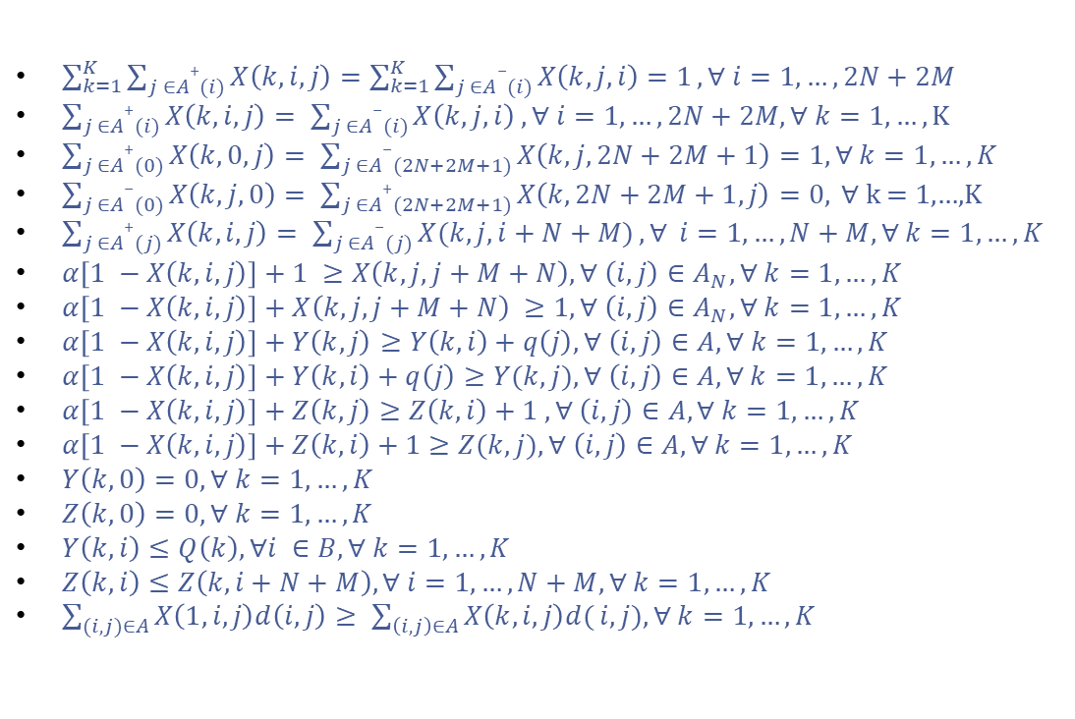
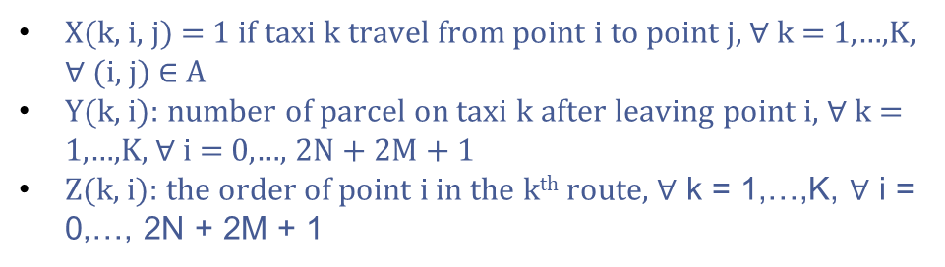
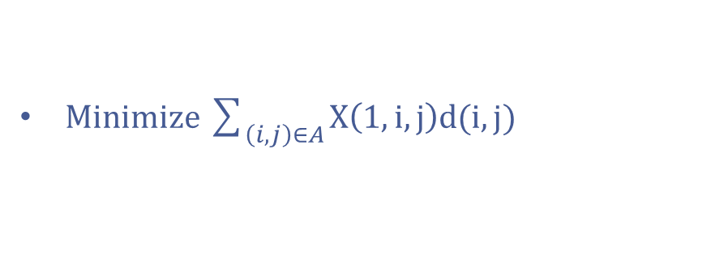
Exact solutions:
Constraint Programming
$\sum_{k=1}^{K}{\sum_{j ∈A+(i)}{X\left(k, i, j\right)=\sum_{k=1}^{K}{\sum_{j ∈A−(i)}{X\left(k, j, i\right)=1}}}}, ∀ i=1,…,2N+2M$
$\sum_{j ∈A+(i)}{X\left(k, i, j\right)= \sum_{j ∈A−(i)}{X\left(k, j, i\right) , ∀ i=1,…,2N+2M, ∀ k=1,…,}}K$
$\sum_{j ∈A+(0)}{X\left(k, 0, j\right)= \sum_{j ∈A−(2N+2M+1)}{X\left(k, j, 2N+2M+1\right)}}=1, ∀ k=1, …, K$
$\sum_{j ∈A−(0)}{X\left(k, j, 0\right)= \sum_{j ∈A+(2N+2M+1)}{X\left(k, 2N+2M+1, j\right)=0,}} ∀$ k = 1,…,K
$\sum_{j ∈A+(j)}{X\left(k, i, j\right)= \sum_{j ∈A−(j)}{X(k, j, i+N+M)}, ∀} i=1, …,N+M, ∀ k=1,…,K$
$α\left[1 −X\left(k, i, j\right)\right]+1 ≥X\left(k, j, j+M+N\right), ∀ \left(i, j\right)∈A_{N}, ∀ k=1,…,K$
$α\left[1 −X\left(k, i, j\right)\right]+X\left(k, j, j+M+N\right) ≥1, ∀ \left(i, j\right)∈A_{N}, ∀ k=1,…,K$
$α\left[1 −X\left(k, i, j\right)\right]+Y\left(k, j\right)≥Y\left(k, i\right)+q\left(j\right), ∀ \left(i, j\right)∈A, ∀ k=1,…,K$
$α\left[1 −X\left(k, i, j\right)\right]+Y\left(k, i\right)+q\left(j\right)≥Y(k, j), ∀ \left(i, j\right)∈A, ∀ k=1,…,K$
$α\left[1 −X\left(k, i, j\right)\right]+Z\left(k, j\right)≥Z\left(k, i\right)+1 , ∀ \left(i, j\right)∈A, ∀ k=1,…,K$
$α\left[1 −X\left(k, i, j\right)\right]+Z\left(k, i\right)+1≥Z(k, j), ∀ \left(i, j\right)∈A, ∀ k=1,…,K$
$Y\left(k, 0\right)=0, ∀ k=1, …,K$
$Z\left(k, 0\right)=0, ∀ k=1, …,K$
$Y\left(k, i\right)≤Q\left(k\right), ∀i ∈B, ∀ k=1, …,K$
$Z\left(k, i\right)≤Z\left(k, i+N+M\right), ∀ i=1,…,N+M, ∀ k=1, …,K$
$\sum_{(i,j)∈A}{X\left(1,i,j\right)d\left(i, j\right)≥ \sum_{\left(i, j\right)∈A}{X\left(k, i, j\right)d(}i,j), ∀ k=1, …,K}$
X(k, i, j) = 1 if taxi k travel from point i to point j, ∀ k = 1,…,K, $∀$(i, j) ∈ A
Y(k, i): number of parcel on taxi k after leaving point i, ∀ k = 1,…,K, ∀ i = 0,…, 2N + 2M + 1
Z(k, i): the order of point i in the k^{th} route, ∀ k = 1,…,K, ∀ i = 0,…, 2N + 2M + 1
Objective function
Minimize $\sum_{\left(ⅈ,j\right)∈A}{X\left(1,i,j\right)d(i,j)}$

Slide 12
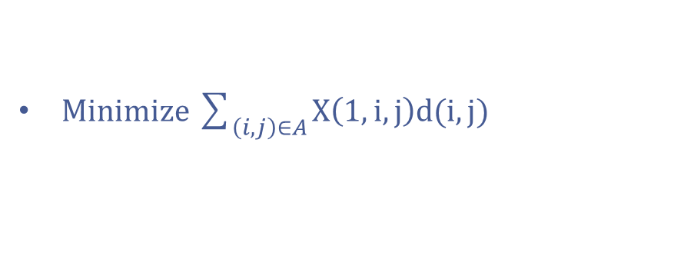
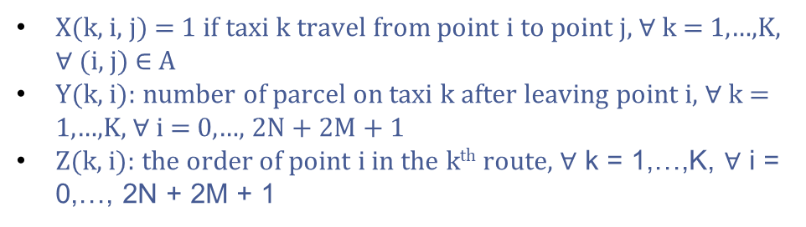
Exact solutions:
Constraint Programming
X(k, i, j) = 1 if taxi k travel from point i to point j, ∀ k = 1,…,K, $∀$(i, j) ∈ A
Y(k, i): number of parcel on taxi k after leaving point i, ∀ k = 1,…,K, ∀ i = 0,…, 2N + 2M + 1
Z(k, i): the order of point i in the k^{th} route, ∀ k = 1,…,K, ∀ i = 0,…, 2N + 2M + 1
Objective function
Minimize $\sum_{\left(ⅈ,j\right)∈A}{X\left(1,i,j\right)d(i,j)}$
$\sum_{k=1}^{K}{\sum_{j ∈A+(i)}{X\left(k, i, j\right)=\sum_{k=1}^{K}{\sum_{j ∈A−(i)}{X\left(k, j, i\right)=1}}}}, ∀ i=1,…,2N+2M$
$\sum_{j ∈A+(i)}{X\left(k, i, j\right)= \sum_{j ∈A−(i)}{X\left(k, j, i\right) , ∀ i=1,…,2N+2M, ∀ k=1,…,}}K$
$\sum_{j ∈A+(0)}{X\left(k, 0, j\right)= \sum_{j ∈A−(2N+2M+1)}{X\left(k, j, 2N+2M+1\right)}}=1, ∀ k=1, …, K$
$\sum_{j ∈A−(0)}{X\left(k, j, 0\right)= \sum_{j ∈A+(2N+2M+1)}{X\left(k, 2N+2M+1, j\right)=0,}} ∀$ k = 1,…,K
$\sum_{j ∈A+(j)}{X\left(k, i, j\right)= \sum_{j ∈A−(j)}{X(k, j, i+N+M)}, ∀} i=1, …,N+M, ∀ k=1,…,K$
$α\left[1 −X\left(k, i, j\right)\right]+1 ≥X\left(k, j, j+M+N\right), ∀ \left(i, j\right)∈A_{N}, ∀ k=1,…,K$
$α\left[1 −X\left(k, i, j\right)\right]+X\left(k, j, j+M+N\right) ≥1, ∀ \left(i, j\right)∈A_{N}, ∀ k=1,…,K$
$α\left[1 −X\left(k, i, j\right)\right]+Y\left(k, j\right)≥Y\left(k, i\right)+q\left(j\right), ∀ \left(i, j\right)∈A, ∀ k=1,…,K$
$α\left[1 −X\left(k, i, j\right)\right]+Y\left(k, i\right)+q\left(j\right)≥Y(k, j), ∀ \left(i, j\right)∈A, ∀ k=1,…,K$
$α\left[1 −X\left(k, i, j\right)\right]+Z\left(k, j\right)≥Z\left(k, i\right)+1 , ∀ \left(i, j\right)∈A, ∀ k=1,…,K$
$α\left[1 −X\left(k, i, j\right)\right]+Z\left(k, i\right)+1≥Z(k, j), ∀ \left(i, j\right)∈A, ∀ k=1,…,K$
$Y\left(k, 0\right)=0, ∀ k=1, …,K$
$Z\left(k, 0\right)=0, ∀ k=1, …,K$
$Y\left(k, i\right)≤Q\left(k\right), ∀i ∈B, ∀ k=1, …,K$
$Z\left(k, i\right)≤Z\left(k, i+N+M\right), ∀ i=1,…,N+M, ∀ k=1, …,K$
$\sum_{(i,j)∈A}{X\left(1,i,j\right)d\left(i, j\right)≥ \sum_{\left(i, j\right)∈A}{X\left(k, i, j\right)d(}i,j), ∀ k=1, …,K}$

Slide 13
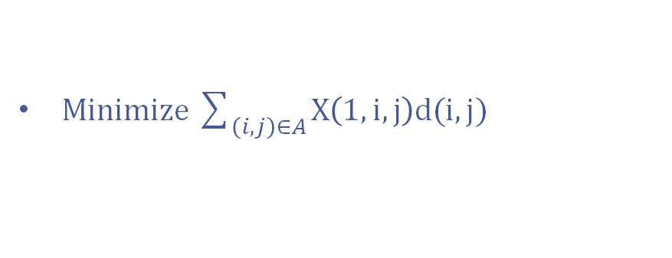
Exact solutions:
Constraint Programming
B = {0,…, 2N + 2M + 1}
F = {(i, i) | i ∈ B}
A = B² \ F
A_{N} = {(i, j) | j ∈{1,…,N}}
A⁺(j) = { j | (i, j) ∈A}
A⁻(j) = { j | (j, i) ∈ A}
Objective function
Minimize $\sum_{\left(ⅈ,j\right)∈A}{X\left(1,i,j\right)d(i,j)}$

Slide 14
B = {0,…, 2N + 2M + 1}
F = {(i, i) | i ∈ B}
A = B² \ F
A_{N} = {(i, j) | j ∈{1,…,N}}
A⁺(j) = { j | (i, j) ∈A}
A⁻(j) = { j | (j, i) ∈ A}
X(k, i, j) = 1 if taxi k travel from point i to point j, ∀ k = 1,…,K, (i, j) ∈ A
Y(k, i): number of parcels on taxi k after leaving point i, ∀ k = 1,…,K, ∀ i = 0,…, 2N + 2M + 1
Z(k, i): the order of point i in the k^{th} route, ∀ k = 1,…,K, ∀ i = 0,…, 2N + 2M + 1
Expanding list q
Example: N, M, K = 3, 3, 2
q = [8, 4, 5]
=>q = [0, 0, 0, 0, 8, 4, 5, 0, 0, 0, -8, -4, -5, 0]
Exact solutions:
Constraint Programming

Slide 15
B = {0,…, 2N + 2M + 1}
F = {(i, i) | i ∈ B}
A = B² \ F
A_{N} = {(i, j) | j ∈{1,…,N}}
A⁺(j) = { j | (i, j) ∈A}
A⁻(j) = { j | (j, i) ∈ A}
Expanding list q
Example: N, M, K = 3, 3, 2
q = [8, 4, 5]
=>q = [0, 0, 0, 0, 8, 4, 5, 0, 0, 0, -8, -4, -5, 0]
X(k, i, j) = 1 if taxi k travel from point i to point j, ∀ k = 1,…,K, (i, j) ∈ A
Y(k, i): number of parcels on taxi k after leaving point i, ∀ k = 1,…,K, ∀ i = 0,…, 2N + 2M + 1
Z(k, i): the order of point i in the k^{th} route, ∀ k = 1,…,K, ∀ i = 0,…, 2N + 2M + 1

Slide 16
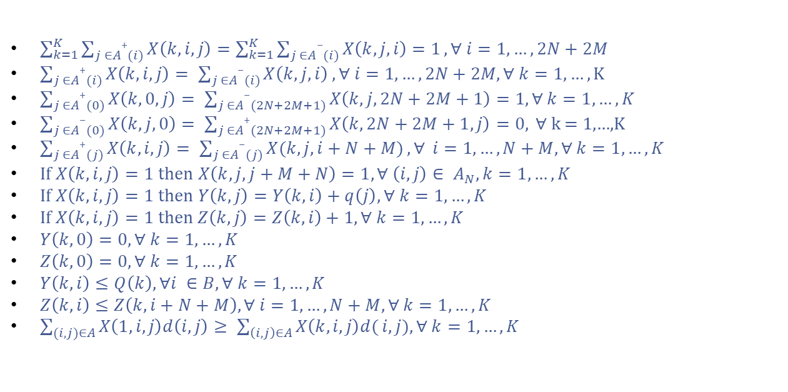
Constraints
Expanding list q
Example: N, M, K = 3, 3, 2
q = [8, 4, 5]
=>q = [0, 0, 0, 0, 8, 4, 5, 0, 0, 0, -8, -4, -5, 0]
X(k, i, j) = 1 if taxi k travel from point i to point j, ∀ k = 1,…,K, (i, j) ∈ A
Y(k, i): number of parcels on taxi k after leaving point i, ∀ k = 1,…,K, ∀ i = 0,…, 2N + 2M + 1
Z(k, i): the order of point i in the k^{th} route, ∀ k = 1,…,K, ∀ i = 0,…, 2N + 2M + 1
$\sum_{k=1}^{K}{\sum_{j ∈A+(i)}{X\left(k, i, j\right)=\sum_{k=1}^{K}{\sum_{j ∈A−(i)}{X\left(k, j, i\right)=1}}}}, ∀ i=1,…,2N+2M$
$\sum_{j ∈A+(i)}{X\left(k, i, j\right)= \sum_{j ∈A−(i)}{X\left(k, j, i\right) , ∀ i=1,…,2N+2M, ∀ k=1,…,}}K$
$\sum_{j ∈A+(0)}{X\left(k, 0, j\right)= \sum_{j ∈A−(2N+2M+1)}{X\left(k, j, 2N+2M+1\right)}}=1, ∀ k=1, …, K$
$\sum_{j ∈A−(0)}{X\left(k, j, 0\right)= \sum_{j ∈A+(2N+2M+1)}{X\left(k, 2N+2M+1, j\right)=0,}} ∀$ k = 1,…,K
$\sum_{j ∈A+(j)}{X\left(k, i, j\right)= \sum_{j ∈A−(j)}{X(k, j, i+N+M)}, ∀} i=1, …,N+M, ∀ k=1,…,K$
If $X\left(k,i,j\right)=1$ then $X\left(k, j, j+M+N\right)=1, ∀ \left(i, j\right)∈ A_{N}, k=1,…, K$
If $X\left(k,i,j\right)=1$ then $Y\left(k, j\right)=Y\left(k, i\right)+q\left(j\right), ∀ k=1,…, K$
If $X\left(k, i, j\right)=1$then $Z\left(k, j\right)=Z\left(k, i\right)+1, ∀ k=1,…,K$
$Y\left(k, 0\right)=0, ∀ k=1, …,K$
$Z\left(k, 0\right)=0, ∀ k=1, …,K$
$Y\left(k, i\right)≤Q\left(k\right), ∀i ∈B, ∀ k=1, …,K$
$Z\left(k, i\right)≤Z\left(k, i+N+M\right), ∀ i=1,…,N+M, ∀ k=1, …,K$
$\sum_{(i,j)∈A}{X\left(1,i,j\right)d\left(i, j\right)≥ \sum_{\left(i, j\right)∈A}{X\left(k, i, j\right)d(}i,j), ∀ k=1, …,K}$

Slide 17
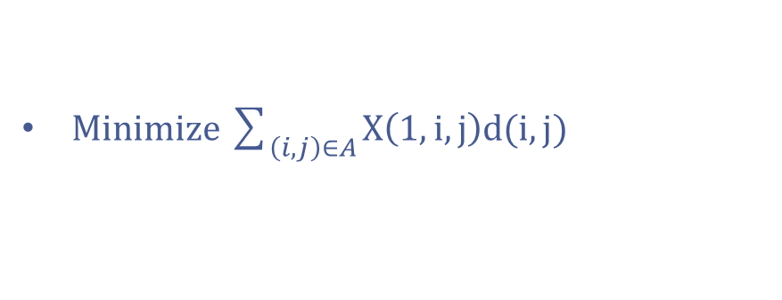

Constraints
$\sum_{k=1}^{K}{\sum_{j ∈A+(i)}{X\left(k, i, j\right)=\sum_{k=1}^{K}{\sum_{j ∈A−(i)}{X\left(k, j, i\right)=1}}}}, ∀ i=1,…,2N+2M$
$\sum_{j ∈A+(i)}{X\left(k, i, j\right)= \sum_{j ∈A−(i)}{X\left(k, j, i\right) , ∀ i=1,…,2N+2M, ∀ k=1,…,}}K$
$\sum_{j ∈A+(0)}{X\left(k, 0, j\right)= \sum_{j ∈A−(2N+2M+1)}{X\left(k, j, 2N+2M+1\right)}}=1, ∀ k=1, …, K$
$\sum_{j ∈A−(0)}{X\left(k, j, 0\right)= \sum_{j ∈A+(2N+2M+1)}{X\left(k, 2N+2M+1, j\right)=0,}} ∀$ k = 1,…,K
$\sum_{j ∈A+(j)}{X\left(k, i, j\right)= \sum_{j ∈A−(j)}{X(k, j, i+N+M)}, ∀} i=1, …,N+M, ∀ k=1,…,K$
If $X\left(k,i,j\right)=1$ then $X\left(k, j, j+M+N\right)=1, ∀ \left(i, j\right)∈ A_{N}, k=1,…, K$
If $X\left(k,i,j\right)=1$ then $Y\left(k, j\right)=Y\left(k, i\right)+q\left(j\right), ∀ k=1,…, K$
If $X\left(k, i, j\right)=1$then $Z\left(k, j\right)=Z\left(k, i\right)+1, ∀ k=1,…,K$
$Y\left(k, 0\right)=0, ∀ k=1, …,K$
$Z\left(k, 0\right)=0, ∀ k=1, …,K$
$Y\left(k, i\right)≤Q\left(k\right), ∀i ∈B, ∀ k=1, …,K$
$Z\left(k, i\right)≤Z\left(k, i+N+M\right), ∀ i=1,…,N+M, ∀ k=1, …,K$
$\sum_{(i,j)∈A}{X\left(1,i,j\right)d\left(i, j\right)≥ \sum_{\left(i, j\right)∈A}{X\left(k, i, j\right)d(}i,j), ∀ k=1, …,K}$
Objective function
X(k, i, j) = 1 if taxi k travel from point i to point j, ∀ k = 1,…,K, (i, j) ∈ A
Y(k, i): number of parcels on taxi k after leaving point i, ∀ k = 1,…,K, ∀ i = 0,…, 2N + 2M + 1
Z(k, i): the order of point i in the k^{th} route, ∀ k = 1,…,K, ∀ i = 0,…, 2N + 2M + 1
Minimize $\sum_{\left(ⅈ,j\right)∈A}{X\left(1,i,j\right)d(i,j)}$

Slide 18
Constraints
Objective function
Minimize $\sum_{\left(ⅈ,j\right)∈A}{X\left(1,i,j\right)d(i,j)}$
$\sum_{k=1}^{K}{\sum_{j ∈A+(i)}{X\left(k, i, j\right)=\sum_{k=1}^{K}{\sum_{j ∈A−(i)}{X\left(k, j, i\right)=1}}}}, ∀ i=1,…,2N+2M$
$\sum_{j ∈A+(i)}{X\left(k, i, j\right)= \sum_{j ∈A−(i)}{X\left(k, j, i\right) , ∀ i=1,…,2N+2M, ∀ k=1,…,}}K$
$\sum_{j ∈A+(0)}{X\left(k, 0, j\right)= \sum_{j ∈A−(2N+2M+1)}{X\left(k, j, 2N+2M+1\right)}}=1, ∀ k=1, …, K$
$\sum_{j ∈A−(0)}{X\left(k, j, 0\right)= \sum_{j ∈A+(2N+2M+1)}{X\left(k, 2N+2M+1, j\right)=0,}} ∀$ k = 1,…,K
$\sum_{j ∈A+(j)}{X\left(k, i, j\right)= \sum_{j ∈A−(j)}{X(k, j, i+N+M)}, ∀} i=1, …,N+M, ∀ k=1,…,K$
If $X\left(k,i,j\right)=1$ then $X\left(k, j, j+M+N\right)=1, ∀ \left(i, j\right)∈ A_{N}, k=1,…, K$
If $X\left(k,i,j\right)=1$ then $Y\left(k, j\right)=Y\left(k, i\right)+q\left(j\right), ∀ k=1,…, K$
If $X\left(k, i, j\right)=1$then $Z\left(k, j\right)=Z\left(k, i\right)+1, ∀ k=1,…,K$
$Y\left(k, 0\right)=0, ∀ k=1, …,K$
$Z\left(k, 0\right)=0, ∀ k=1, …,K$
$Y\left(k, i\right)≤Q\left(k\right), ∀i ∈B, ∀ k=1, …,K$
$Z\left(k, i\right)≤Z\left(k, i+N+M\right), ∀ i=1,…,N+M, ∀ k=1, …,K$
$\sum_{(i,j)∈A}{X\left(1,i,j\right)d\left(i, j\right)≥ \sum_{\left(i, j\right)∈A}{X\left(k, i, j\right)d(}i,j), ∀ k=1, …,K}$
Greedy
Algorithms

Slide 19
Introduction to Greedy Algorithms
Example:
This algorithm builds up solutions piece by piece, solutions made by greedy algorithms are based on the best decision made at each step with a hope to find the global optimum.
Therefore, greedy algorithms do NOT always give an optimal/feasible solution.
Find the longest route:
Objective function
Greedy
Algorithms
5
Minimize $\sum_{\left(ⅈ,j\right)∈A}{X\left(1,i,j\right)d(i,j)}$
2
4
7
9
6
1
Greedy return 5 + 4 + 1 = 15

Slide 20




Adapting into PPSAR problem
Blue taxi, you are next because you just traveled 3 miles
As the name, we will be greedy by choosing the taxi with the lowest distance traveled.
And to do so we make data structures to store everything first:
Routes each taxi traveled
Distances each taxi traveled
Points that all taxis traveled
3
9
Introduction to Greedy Algorithms
Example:
This algorithm builds up solutions piece by piece, solutions made by greedy algorithms are based on the best decision made at each step with a hope to find the global optimum.
Therefore, greedy algorithms do NOT always give an optimal/feasible solution.
Find the longest route:
5
2
4
7
9
6
1
Greedy return 5 + 4 + 1 = 15
Greedy
Algorithms

Slide 21


Introduction to Greedy Algorithms
Adapting into PPSAR problem
This is point 9, Nairyuuu said I pick up this passenger here and travel to node 9 + N + M
Example:
As the name, we will be greedy by choosing the taxi with the lowest distance traveled.
And to do so we make data structures to store everything first:
Routes each taxi traveled
Distances each taxi traveled
Points that all taxis traveled
This algorithm builds up solutions piece by piece, solutions made by greedy algorithms are based on the best decision made at each step with a hope to find the global optimum.
Therefore, greedy algorithms do NOT always give an optimal/feasible solution.
Blue taxi, you are next because you just traveled 3 miles
Pick the closest point (minimum distance that increases) that is not visited or not bypassing the capacity of that chosen taxi after picking up that parcel at the point and make it arrive there:
While doing so, we will see:
If the point the taxi arrives is a parcel request, add the distance traveled to that point.
Else, make it move straight to the passenger’s destination and add the distance traveled to the point and the destination.
Find the longest route:
5
3
5
2
4
9
7
9
6
1
Greedy return 5 + 4 + 1 = 15
9
routes[best_taxi].append(this_node)
routes[best_taxi].append(this_node + N + M)

Slide 22
Adapting into PPSAR problem
This is point 9, Nairyuuu said I pick up this passenger here and travel to poimt 9 + N + M
Pick the closest point (minimum distance that increases) that is not visited or not bypassing the capacity of that chosen taxi after picking up that parcel at the point and make it arrive there:
While doing so, we will see:
If the point the taxi arrives is a parcel request, add the distance traveled to that point.
Else, make it move straight to the passenger’s destination and add the distance traveled to the point and the destination.
As the name, we will be greedy by choosing the taxi with the lowest distance traveled.
And to do so we make data structures to store everything first:
Routes each taxi traveled
Distances each taxi traveled
Points that all taxis traveled
We repeat the previous step until every point got visited.
And when all taxis arrives at the depot again, they will tell us everything we need.
9
routes[best_taxi].append(this_point)
routes[best_taxi].append(this_point + N + M)
3
Blue taxi, you are next because you just traveled 3 miles
9

Slide 23


Genetic
Algorithm
Adapting into PPSAR problem
Pick the closest point (minimum distance that increases) that is not visited or not bypassing the capacity of that chosen taxi after picking up that parcel at the point and make it arrive there:
While doing so, we will see:
If the point the taxi arrives is a parcel request, add the distance traveled to that point.
Else, make it move straight to the passenger’s destination and add the distance traveled to the point and the destination.
routes[blue] = [0, 7, 4, 14, 18, 1, 11, 0]
taxi_dist[blue] = 72
We repeat the previous step until every point got visited.
And when all taxis arrives at the depot again, they will tell us everything we need.
9
routes[red] = [0, 17, 9, 6, 8, 20, 3, 13, 0]
taxi_dist[red] = 76
routes[best_taxi].append(this_point)
routes[best_taxi].append(this_point + N + M)
routes[yellow] = [0, 2, 12, 16, 10, 19, 5, 15, 0]
taxi_dist[yellow] = 94

Slide 24

Adapting into PPSAR problem
GA: Introduction
This optimization algorithm is inspired by:
Natural selection
Principles of genetics
Mainly used in finding the approximate solution to optimization and search problems
We repeat the previous step until every point got visited.
And when all taxis arrives at the depot again, they will tell us everything we need.
Genetic
Algorithm

Slide 25
Here’s the basic overview of how Genetic Algorithm (GA) works
GA: Introduction
This optimization algorithm is inspired by:
Natural selection
Principles of genetics
Mainly used in finding the approximate solution to optimization and search problems
Initialize the population of potential solution
Genetic Operations: Selection, Crossover, Mutation.
Fitness Evaluation
Evolutionary Cycle
Termination Criteria
Genetic
Algorithm
Start
Initial Random Population
Evaluate Finess
New population offspring
Selection of optimum solution
Replace
Accept
Crossover
Mutation
Stop

Slide 26
Start
Here’s the basic overview of how Genetic Algorithm (GA) works
GA: Introduction
Initial Random Population
Initialize population
Evaluate Fitness
This optimization algorithm is inspired by:
Natural selection
Principles of genetics
Mainly used in finding the approximate solution to optimization and search problems
Example of population:
Initialize the population of potential solution
Genetic Operations: Selection, Crossover, Mutation.
Fitness Evaluation
Evolutionary Cycle
Termination Criteria
New population offspring
Selection of optimum solution
Replace
Accept
Crossover
Mutation
Stop
4
1
3
2
5
chromosome
1
4
3
4
2
gene
3
2
1
4
5
population
Initialize population is the first stage of the genetic algorithm where we generate several solutions randomly.
And same as how biology works, we perform genetic operations to get the optimal solution

Slide 27
Start
Crossover:
Here’s the basic overview of how Genetic Algorithm (GA) works
Initial Random Population
Initialize population
This is the most vital stage in the genetic algorithm, it is used to create new solutions because it is often difficult for an algorithm to find a good solution on its own. In this case, we use two points crossover.
Evaluate Fitness
Example:
Example of population:
Initialize the population of potential solution
Genetic Operations: Selection, Crossover, Mutation.
Fitness Evaluation
Evolutionary Cycle
Termination Criteria
New population offspring
Parents:
Initialize population is the first stage of the genetic algorithm where we generate several solutions randomly.
And same as how biology works, we perform genetic operations to get the optimal solution
4
1
3
2
5
chromosome
Selection of optimum solution
crossover points
1
4
3
4
2
Replace
gene
Children:
Accept
3
2
1
4
5
Crossover
Mutation
Stop
population

Slide 28
Crossover:
Mutation:
Example:
This is the most vital stage in the genetic algorithm, it is used to create new solutions because it is often difficult for an algorithm to find a good solution on its own. In this case, we use two points crossover.
Example:
In this case this stage generates new solutions simply by making small change to existing ones.
We inspired biological inverse mutation for this stage
Parent 0:
1
2
3
4
5
Parents:
crossover points
Parent 0’:
1
2
4
3
5
Children:

Slide 29
Conclusion
Mutation:
Example:
In this case this stage generates new solutions simply by making small change to existing ones.
We inspired biological inverse mutation for this stage
Parent 0:
1
2
3
4
5
Parent 0’:
1
2
4
3
5

Slide 30


CP Method
Mutation:
Example:
Pros
In this case this stage generates new solutions simply by making small change to existing ones.
We inspired biological inverse mutation for this stage
Parent 0:
1
2
3
4
5
Conclusion
Suitable for problems with complex constraints
Be able to handle nonlinear constraint without linearization
Guarantees the optimal solution
Be well-suit for situations that demand precision
Parent 0’:
1
2
4
3
5

Slide 31




CP Method
Pros
Cons
Suitable for problems with complex constraints
Be able to handle nonlinear constraint without linearization
Guarantees the optimal solution
Be well-suit for situations that demand precision
CP is heavily demanding on computation, especially for large and complex problems
May not be as efficient as ILP for problems that has linear stucture
Optimal
Conclusion

Slide 32
ILP Method
CP Method
Pros
Cons
Suitable for problems with complex constraints
Be able to handle nonlinear constraint without linearization
Guarantees the optimal solution
Be well-suit for situations that demand precision
Stability and predictability in routing processes
ILP models are easily adjustable or extendable to accommodate additional constraints
CP is heavily demanding on computation, especially for large and complex problems
May not be as efficient as ILP for problems that has linear stucture
Optimal

Slide 33



ILP Method
CP Method
Pros
Cons
Stability and predictability in routing processes
ILP models are easily adjustable or extendable to accommodate additional constraints
CP is heavily demanding on computation, especially for large and complex problems
May not be as efficient as ILP for problems that has linear stucture
ILP requires times and is computationally expensive, which makes this method impractical
ILP also has limited scalability as the number of people and parcels increases
Optimal

Slide 34


Greedy Method
ILP Method
Pros
Cons
Greedy algorithms are often simple and easy to understand and implement
Are more efficient comparing to other method, make it practical
Can be used to solve problems that is difficult and impossible to solve exactly
Stability and predictability in routing processes
ILP models are easily adjustable or extendable to accommodate additional constraints
ILP requires times and is computationally expensive, which makes this method impractical
ILP also has limited scalability as the number of people and parcels increases

Slide 35
Greedy Method
Cons
Pros
Cons
Greedy algorithms are often simple and easy to understand and implement
Are more efficient comparing to other method, make it practical
Can be used to solve problems that is difficult and impossible to solve exactly
Not likely to provide the global optimizal solution
Easy to lull oneself into believing they work as it relies heavily on how we provide the constraints for them
2
8
0 4 10 5 11 1 7 0
8
0 6 2 8 12 3 9 0

Slide 36

Greedy Method
GA Method
Pros
Cons
GA are great for global optimization as they can explore a wide range of solution for the problem
Be able to handle problems with non-linear and non-convex problem
Greedy algorithms are often simple and easy to understand and implement
Are more efficient comparing to other method, make it practical
Can be used to solve problems that is difficult and impossible to solve exactly
Not likely to provide the global optimizal solution
Easy to lull oneself into believing they work as it relies heavily on how we provide the constraints for them
2
8
0 4 10 5 11 1 7 0
8
0 6 2 8 12 3 9 0
Not global optimal

Slide 37

GA Method
Pros
Cons
GA are great for global optimization as they can explore a wide range of solution for the problem
Be able to handle problems with non-linear and non-convex problem
GA is computationally complex as it require significant computational resources to run, especially when facing large problem
GA is dependent on randomness, which makes it difficult to evaluate solution and compare with other algorithms
Not likely to provide the global optimizal solution
Easy to lull oneself into believing they work as it relies heavily on how we provide the constraints for them

Slide 38
Comparisons
GA Method
Pros
Cons
GA are great for global optimization as they can explore a wide range of solution for the problem
Be able to handle problems with non-linear and non-convex problem
GA is computationally complex as it require significant computational resources to run, especially when facing large problem
GA is dependent on randomness, which makes it difficult to evaluate solution and compare with other algorithms
Integer Linear programming
Constraint programming
Greedy Algorithms
Genetic Algorithms

Slide 39
Running time of Different solvers
Test | CP | ILP | Greedy | GA
1 | 0,2668 | 0,27 | 0,001 | 1,3512
2 | 3,0454 | 4,4787 | 0,001 | 1,4688
3 | 2,7124 | 3,7591 | 0,001 | 2,0138
4 | 14,037 | 16,037 | 0,0011 | 1,5728
5 | 97,502 | 22,484 | 0,001 | 2,1405
6 | 17,946 | 12,084 | 0,0011 | 1,7978
7 | 105,93 | 136,29 | 0,001 | 2,3035
8 | 338,36 | 468,97 | 0,001 | 2,8062
9 | 27,566 | 44,124 | 0 | 1,9913
10 | 2062,5 | 2157,8 | 0,001 | 2,5575
GA Method
Comparisons
Cons
Integer Linear programming
Constraint programming
Greedy Algorithms
Genetic Algorithms
GA is computationally complex as it require significant computational resources to run, especially when facing large problem
GA is dependent on randomness, which makes it difficult to evaluate solution and compare with other algorithms
*: All tests are run on the same device

Slide 40
Comparisons
Running time of Different solvers
Test | CP | ILP | Greedy | GA
1 | 0,2668 | 0,27 | 0,001 | 1,3512
2 | 3,0454 | 4,4787 | 0,001 | 1,4688
3 | 2,7124 | 3,7591 | 0,001 | 2,0138
4 | 14,037 | 16,037 | 0,0011 | 1,5728
5 | 97,502 | 22,484 | 0,001 | 2,1405
6 | 17,946 | 12,084 | 0,0011 | 1,7978
7 | 105,93 | 136,29 | 0,001 | 2,3035
8 | 338,36 | 468,97 | 0,001 | 2,8062
9 | 27,566 | 44,124 | 0 | 1,9913
10 | 2062,5 | 2157,8 | 0,001 | 2,5575
*: All tests are run on the same device
Integer Linear programming
Constraint programming
Greedy Algorithms
Genetic Algorithms

Slide 41
Comparisons
Running time of Different solvers
Objective Value of Different solvers
Test | CP | ILP | Greedy | GA
1 | 31 | 31 | 44 | 37
2 | 57 | 57 | 94 | 71
3 | 41 | 41 | 82 | 49
4 | 76 | 76 | 148 | 103
5 | 77 | 77 | 99 | 74
6 | 82 | 82 | 196 | 134
7 | 58 | 58 | 114 | 97
8 | 69 | 69 | 120 | 88
9 | 97 | 97 | 323 | 163
10 | 79 | 79 | 155 | 140
*: All tests are run on the same device
Integer Linear programming
Constraint programming
Greedy Algorithms
Genetic Algorithms

Slide 42
Comparisons
Running time of Different solvers
Objective Value of Different solvers
Test | CP | ILP | Greedy | GA
1 | 31 | 31 | 44 | 37
2 | 57 | 57 | 94 | 71
3 | 41 | 41 | 82 | 49
4 | 76 | 76 | 148 | 103
5 | 77 | 77 | 99 | 74
6 | 82 | 82 | 196 | 134
7 | 58 | 58 | 114 | 97
8 | 69 | 69 | 120 | 88
9 | 97 | 97 | 323 | 163
10 | 79 | 79 | 155 | 140
*: All tests are run on the same device
Integer Linear programming
Constraint programming
Greedy Algorithms
Genetic Algorithms

Slide 43
Objective Value of Different solvers
*: All tests are run on the same device
Test | CP | ILP | Greedy | GA
1 | 31 | 31 | 44 | 37
2 | 57 | 57 | 94 | 71
3 | 41 | 41 | 82 | 49
4 | 76 | 76 | 148 | 103
5 | 77 | 77 | 99 | 74
6 | 82 | 82 | 196 | 134
7 | 58 | 58 | 114 | 97
8 | 69 | 69 | 120 | 88
9 | 97 | 97 | 323 | 163
10 | 79 | 79 | 155 | 140

Slide 44
Objective Value of Different solvers
*: All tests are run on the same device

Slide 45
*: All tests are run on the same device
Thank you for listening

Slide 46
Thank you for listening

